Slide 1
Sledge Meeting 10/27/2021

Slide 2
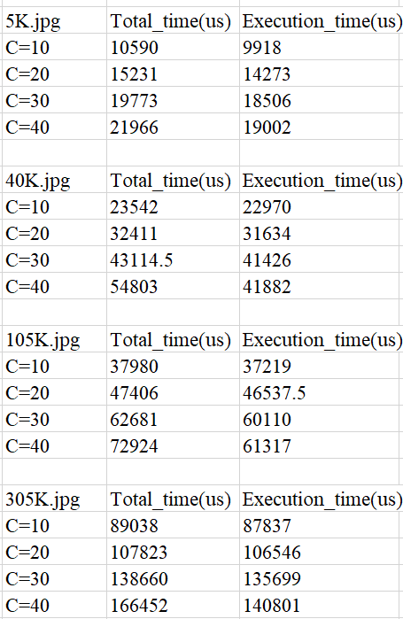
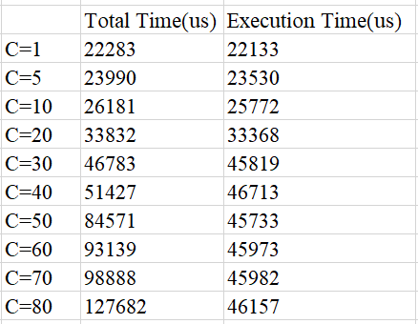
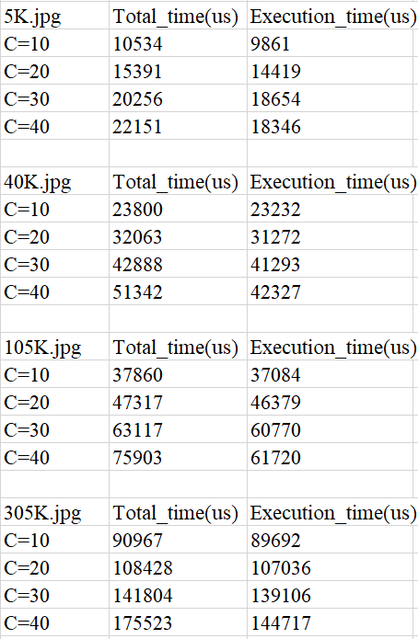
Single Request - Single Function (img Resize)
Single Request - Chain Function
EDF
SRSF

Slide 3
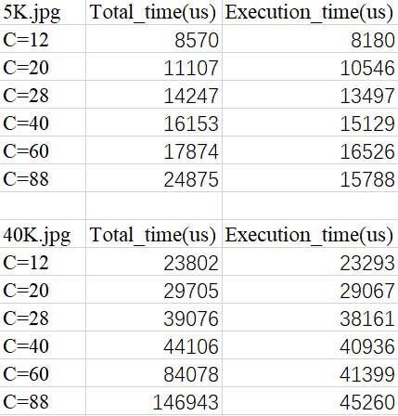
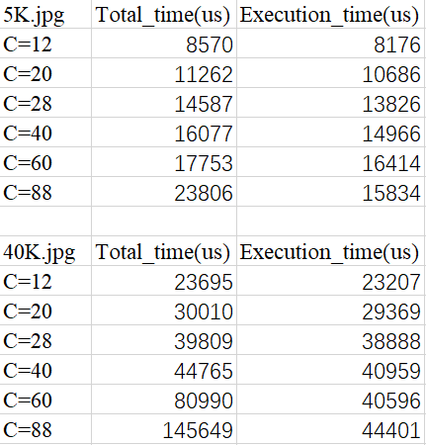
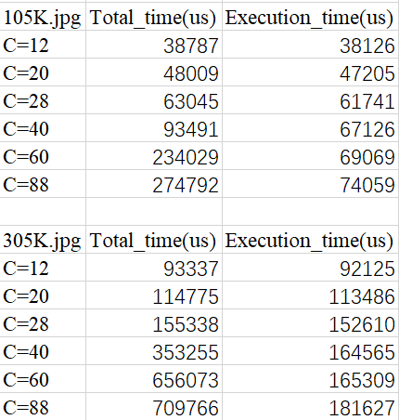
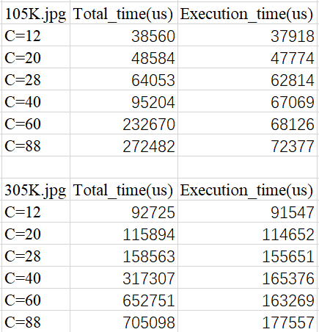
Mixed type of Requests(30 cpu cores)
EDF
SRSF

Slide 4
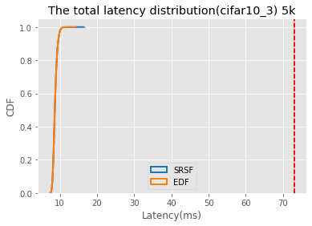
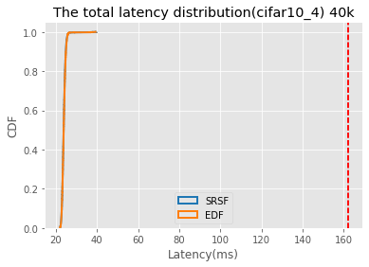


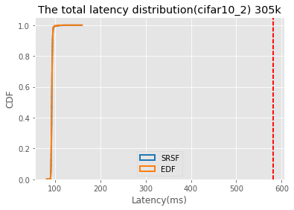

EDF vs SRSF(C=12)
For the light workload, the requests distribution are the same, all requests meet their deadline
SRSF:
cifar10_3 :max latency is:16662 us
cifar10_4: max latency is:39746 us
cifar10_1 : max latency is:68361 us
cifar10_2 : max latency is:159235 us
EDF:
cifar10_3 max latency is:14436 us
cifar10_4 max latency is:39674 us
cifar10_1 max latency is:70873 us
cifar10_2 max latency is:161617 us

Slide 5
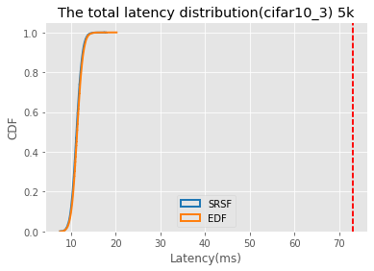
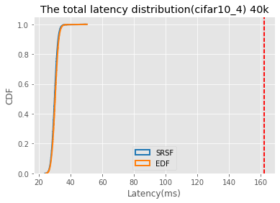

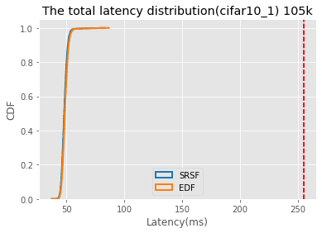
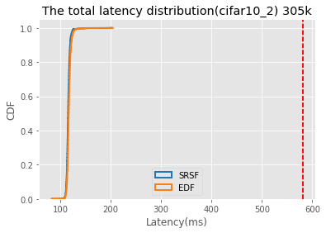

EDF vs SRSF(c=20)
For light workload, all requests meet their deadline, it seems SRSF has a shorter tail latency then EDF, but don’t know if this is randomness

Slide 6
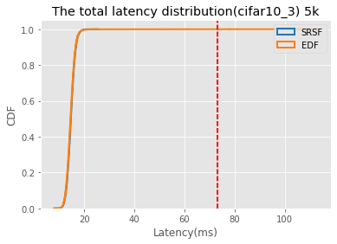
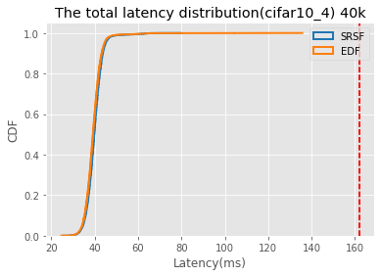



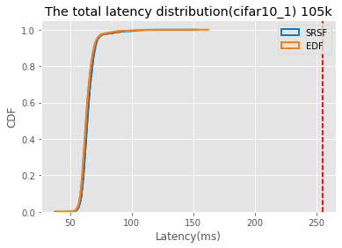
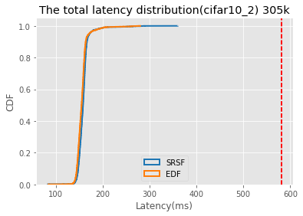
EDF vs SRSF(C=28)
For light workload, SRSF has a shorter tail latency then EDF with 5k, 40k and 105k requests, but longer tail latency than EDF with 305k requests, but don’t know if this is randomness.

Slide 7
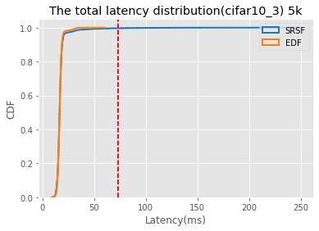
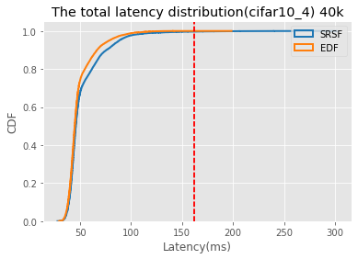


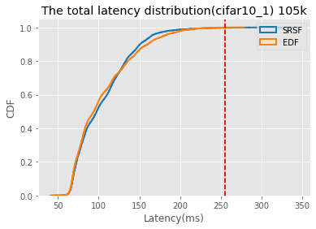
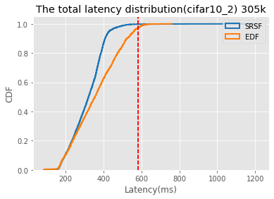

EDF vs SRSF(C=40)

Slide 8
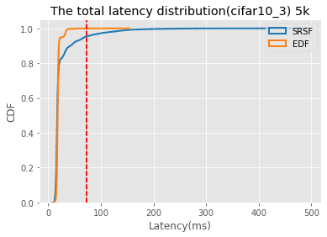
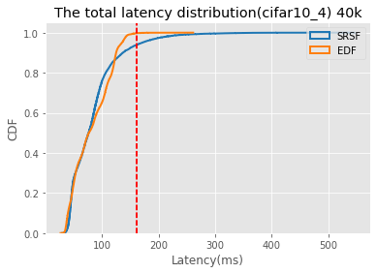


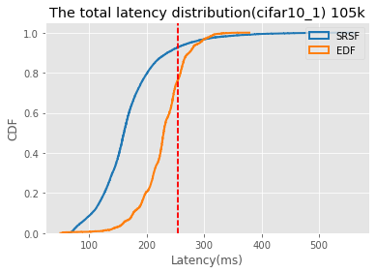
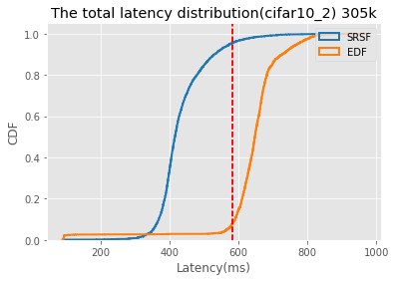

EDF vs SRSF(C=60)

Slide 9
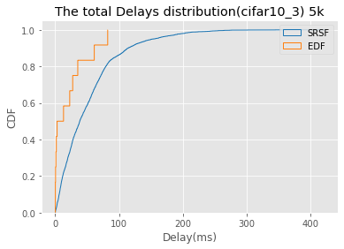
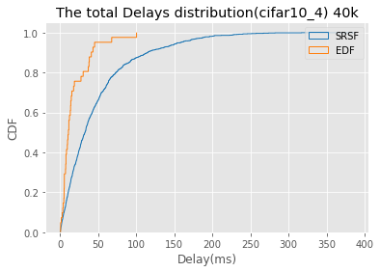
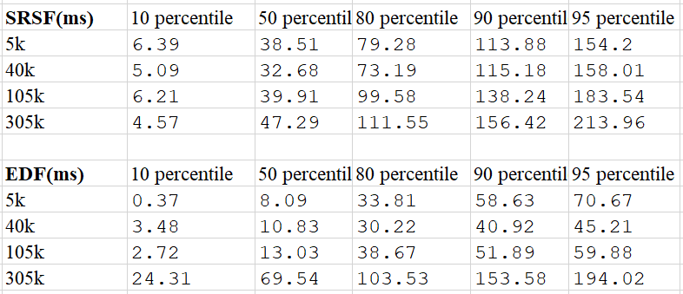
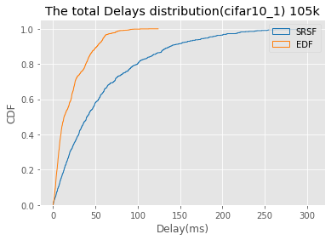
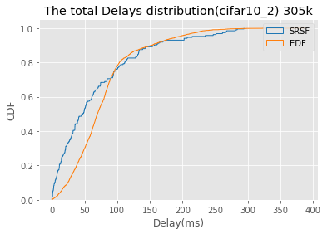
EDF vs SRSF(C=60)
Delays Distribution
SRSF:
function: 5k 99% p delays: 229
function: 40k 99% p delays: 228
function: 105k 99% p delays: 245
function: 305k 99% p delays: 281
EDF:
function: 5k 99% p delays: 79
function: 40k 99% p delays: 87
function: 105k 99% p delays: 80
function: 305k 99% p delays: 248

Slide 10
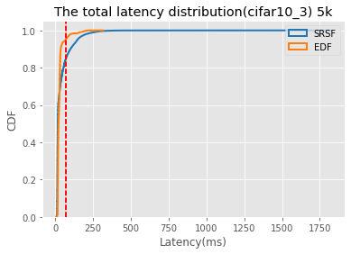
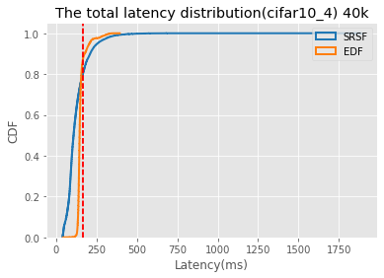


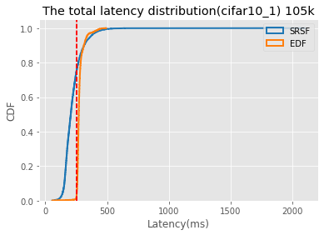
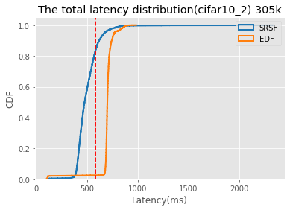

EDF vs SRSF(C=88)

Slide 11
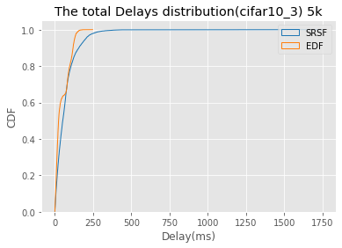
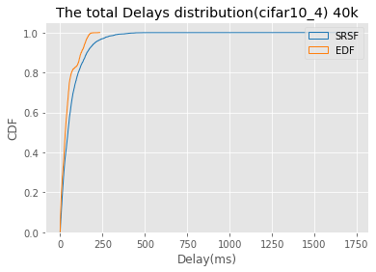
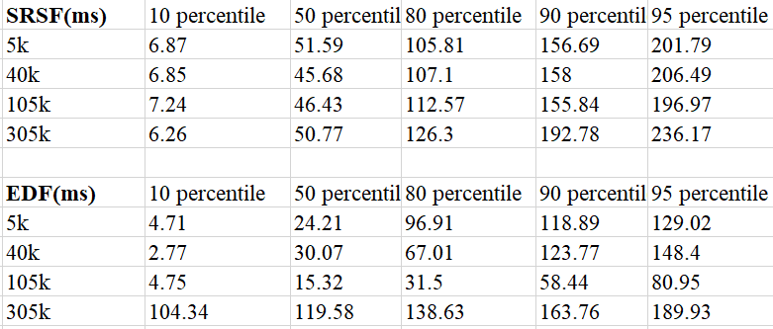
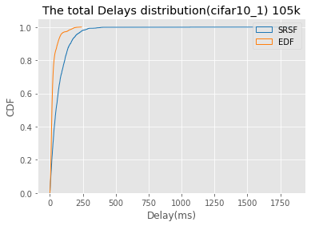
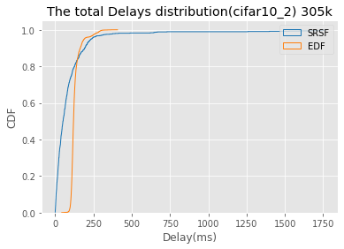
EDF vs SRSF(C=88)
Lateness Distribution
SRSF:
function: 5k 99% p delays: 294
function: 40k 99% p delays: 335
function: 105k 99% p delays: 287
function: 305k 99% p delays: 1005
EDF:
function: 5k 99% p delays: 150
function: 40k 99% p delays: 170
function: 105k 99% p delays: 170
function: 305k 99% p delays: 286

Slide 12
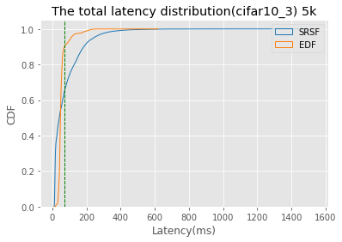
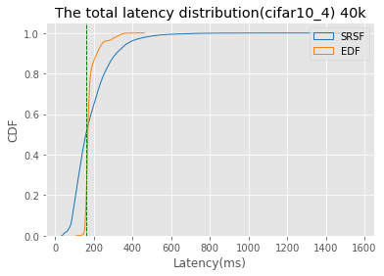


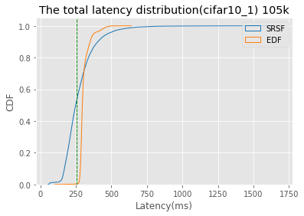
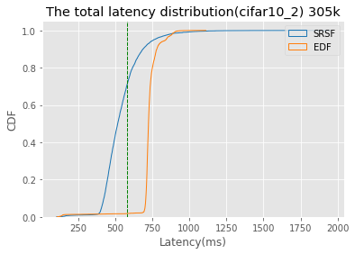

EDF vs SRSF(C=120)

Slide 13
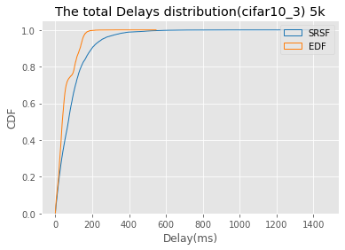
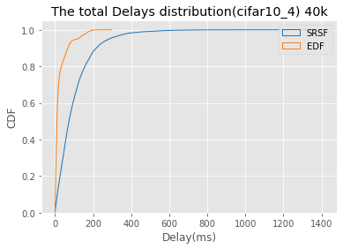
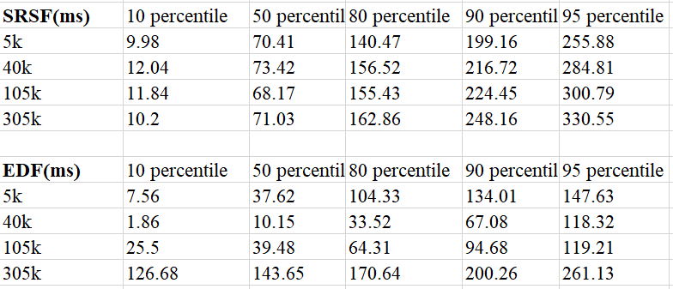

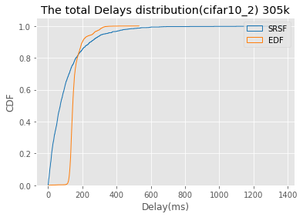
EDF vs SRSF(C=120)
Delays Distribution
SRSF:
function: 5k 99% p delays: 437
function: 40k 99% p delays: 474
function: 105k 99% p delays: 513
function: 305k 99% p delays: 575
EDF:
function: 5k 99% p delays: 172
function: 40k 99% p delays: 175
function: 105k 99% p delays: 201
function: 305k 99% p delays: 317

Slide 14
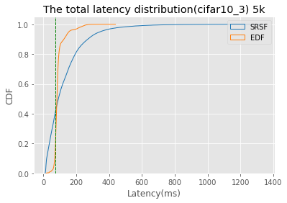




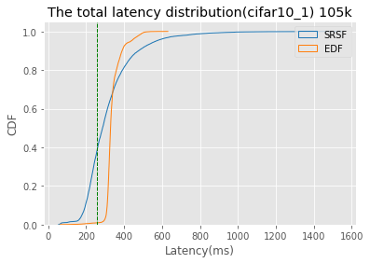




EDF vs SRSF(C=152)

Slide 15





EDF vs SRSF(C=152)
Delays Distribution
SRSF:
function: 5k 99% p delays: 587
function: 40k 99% p delays: 613
function: 105k 99% p delays: 650
function: 305k 99% p delays: 799
EDF:
function: 5k 99% p delays: 175
function: 40k 99% p delays: 206
function: 105k 99% p delays: 237
function: 305k 99% p delays: 340

Slide 16




Requests Distribution

Slide 17
Sledge Meeting 11/2/2021

Slide 18

Execution Time With Single Function
System has 32 CPU cores
CPU 0 is “idle” for OS processes, CPU 1 is for Sledge main thread and listening thread.
CPU=28 means start 28 worker threads and let 2 cpu cores “idle”

Slide 19

Execution Time With Single Function
System has 32 CPU cores
CPU 0 is “idle” for OS processes, CPU 1 is for Sledge main thread and listening thread.
CPU=28 means start 28 worker threads and let 2 cpu cores “idle”

Slide 20
Single Function Execution Time(from a decision of running a sandbox has been made to the http response been sent out)
Non-blocking read data from network (if blocked, blocking time will be subtracted from execution time)
Calling two wasm apis (populate_globals and populate_memory)
Execute function code
Non-blocking write data to the client( if blocked, blocking time will be subtracted from execution time)
If preemption happened in 3 (couldn’t be in 1,2,4 because these steps are nonpreemptible), preemption time will be subtracted from execution time)

Slide 21

Execution Time Breakdown(30 Worker threads, concurrency 1 and 40)

Slide 22


Linux Total threads
CPU time slice is expired – threads context switch (might not be the main contribution to the overhead)
System call(mode switch overhead)
More requests will have more system calls (read/write) and more mode switches overhead.(flush cache? More Cache miss)
C1: 4252 , C40: 61222
Direct and indirect overhead:
Direct: Context switch – save registers, TLB, page table for the current thread and restore registers, page table and TLB for the next thread.
Indirect: When context switch, cause cache miss.

Slide 23




C=40 run 60 seconds: Context switch
C=1 run 60 seconds: Context switch

Slide 24


C=40 run 60 seconds:
Page fault
C=1 run 60 seconds:
Page fault

Slide 25


C=40 run 60 seconds:
Cache miss
C=1 run 60 seconds:
Cache miss

Slide 26


C=40
C=1

Slide 27
Sledge Meeting 11/10/2021

Slide 28



Execution Time With Single Function(image resize)

Slide 29




LoadTest: Poisson Distribution

Slide 30
Calculate Sending Rate To Overload or Underload
5k: 18346
40k: 42327
105k:61720
305k:144717
40k: 2.3 times of 5k
105k: 3.3 times of 5k
305k: 7.8 times of 5k
Total capacity for 5k in one cpu core = 1000/18 = 55 rps
Total capacity for 5k in 30 cpu core = 55 rps * 30 = 1666 rps (60%, 65%, 70%, 75%, 80%)
4 loadtest, each one get 1666/4= 416 rps – 53.6%
For 40k, should be 416 rps / 2.3 = 181 rps – 23.3%
For 105k, should be 416 rps / 3.3 = 126 rps – 16.2%
For 305k, should be 416 rps / 7.8 = 53 rps – 6.8%
For 5k – 60% - 527
For 40k - 25% - 220
For 105k - 10% - 88
For 305k– 5% - 44

Slide 31


Result is not stable(Mixed requests) – miss deadline rate
Miss deadline rate
RPS Settings
4 loadtest, C =1, 401 RPS, 167 RPS,
401 * 120 =

Slide 32

Result is not stable(single requests) – miss deadline rate
Miss deadline rate

